Slide 1
Disaster recovery mechanism with active storage replication and DNS failover in cloud Virtual Machine
Domain: Networking, Web Development
BATCH A15
Kolla Priya(211418104129)
Kuricheti Spoorthi(211418104136)
Balasa Chenchu Sai Vyshnavi(211418104036)
Project Guide: Mrs. Devi R

Slide 2
PROJECT OVERVIEW
The Domain Name System (DNS) is a vital service in the Internet. Much more than a simple translation mechanism, it also allows higher profile functionalities such as load balancing and enhanced content distribution.
In the scope of cloud computing, DNS is foreseen as an elastic and robust service, supporting failover mechanisms, decentralised configuration and multi-tenant isolation.
The problem arises where a particular DNS is not able to point an IP address of the server because of heavy traffic, DDoS attack, system crash and much more reasons.
During this period there are huge chances for an organization to be a victim of huge, valuable data loss and have a downtime for a certain period.
This will cause a billion dollar business impact and risk of losing data.
To overcome this we come up with an approach of DNS Failover with active Replication which is a solution designed to help keep the services online and prevent from Data losses.
When systems and services go down DNS failover is used to direct the users to another resource with little to no disruption which has active replication of Data with the current prod Server.
The backup server/ Replicating server is named as Contingency server (CNR) which has a active storage replication with the Production server preventing Data loss.

Slide 3
LITERATURE SURVEY
Title - 1 : A novel dynamic data replication strategy to improve access efficiency of cloud storage.
Authors : S. N. John and T. T. Mirnalinee
Year : 2020
Journal name: Information Systems and e-Business Management (volume-18)
Methodology : Proposed another algorithm, namely RSPC, that introduced a replication strategy that satisfies the tenant objectives and the provider profit. It proposed a popularity-based file selection strategy through analyzing data access by users in a determined period of time
Pros : Introduced a replication strategy that satisfies the tenant objectives and the provider profit.
Cons : The mentioned method has delay > 30 min in replacing the data, which is not suitable for large business needs.

Slide 4
LITERATURE SURVEY
Title-2 : A CSO-based approach for secure data replication in cloud computing environment"
Authors : N. Mansouri, M. M. Javidi and B. M. H. Zade
Year : 2020
Journal name: The Journal of Supercomputing
Methodology : Proposed the Secure Data Replication (SDR) algorithm, which identifies popular files as replication candidates based on the number of file-access times, where the higher the number of file-access times, the higher the popularity. Thereafter, only 20% of the candidates will be selected for replication.
Pros : Identifies popular files as replication candidates based on the number of file-access time.
Cons : The higher the number of file-access times, the higher the popularity

Slide 5
LITERATURE SURVEY
Title-3 : Hierarchical data replication strategy to improve performance in cloud computing
Authors : N. Mansouri, M. M. Javidi and B. M. H. Zade
Year : 2021
Journal name: Frontiers of Computer Science
Methodology : Proposed a dynamic replication algorithm namely Hierarchical Data Replication Strategy (HDRS). It identifies the popularity of a file based on a predicted number of file-access times then it replicates that popular file into the best site using network level locality.
Pros : It identifies the popularity of a file based on a predicted number of file-access times then it replicates that popular file into the best site using network level locality.
Cons : Prediction on the number of files is not always correct may be wrong in some cases.

Slide 6
LITERATURE SURVEY
Title-4 : Cost-effective replication management and scheduling in edge computing
Authors : Yanling Shao, Chunlin Li, Zhao Fu, Jia Leyue, Luo Youlong
Year : 2019
Journal name: Journal of Network and Computer Applications
Methodology : Proposed the Dynamic Replica Creation Algorithm (DRCA) and Data Replica Scheduling Algorithm (DRSA) based on a meta-heuristic approach, in which file selection is done based on its popularity
Pros: It is approach, in which file selection is done based on its popularity
Cons : It takes the file repetition and does the file selection .

Slide 7
LITERATURE SURVEY
Title-5 : Data replica placement policy based on load balance in cloud storage system
Authors : Xiong Fu; Jian Li; Wenjie Liu; Song Deng; Junchang Wang
Year : 2019
Journal name: IEEE 3rd Information Technology,Networking,Electronic and Automation Control Conference (ITNEC 2019)
Methodology : proposed the Replica Placement Based on Load Balance (RPBLB) technique to reduce remote users’ access time. RPBLB suggested duplicating the most used data to new storage without neglecting the storage load balancing.
Pros : proposed the Replica Placement Based on Load Balance (RPBLB) technique to reduce remote users’ access time.
Cons : RPBLB suggested duplicating the most used data to new storage without neglecting the storage load balancing

Slide 8
LITERATURE SURVEY
Title-6 : Fault-Tolerance in the Scope of Software-Defined Networking (SDN)
Authors : A. U. Rehman, R. L. Aguiar and J. P. Barraca
Year : 2019
Journal name: IEEE Access ( Volume: 7)
Methodology : proposed make function such as firewall and Domain Name Service (DNS) to their customers. Under the traditional network architecture, it would be very time consuming and expensive to provide such functions.
Pros : It make function such as firewall and Domain Name Service (DNS) to their customers.
Cons : the control plane and the data plane are bound together, the network is “vertically integrated” which makes it very complicated to reconfigure the system each time there is a change or even making it dynamically reconfigurable

Slide 9
LITERATURE SURVEY
Title-7 : Ziggurat: A tiered file system for non-volatile main memories and disks,”
Authors : S. Zheng, M. Hoseinzadeh, and S. Swanson
Year : 2019
Journal name: 17th USENIX Conference on File and Storage Technologies (FAST ’19)
Methodology : proposed Emerging fast, byte-addressable Non-Volatile Main Memory (NVMM) provides huge increases in storage performance compared to traditional disks, present Ziggurat, a tiered file system that combines NVMM and slow disks to create a storage system with near-NVMM performance and large capacity.
Pros : It provides huge increases in storage performance compared to traditional disks
Cons : Thus, a few SSDs in a storage server can overwhelm 100Gb/s Ethernet. Faster technologies such as Intel Optane

Slide 10
LITERATURE SURVEY
Title-8 : Constraints Mitigation in Cognitive Radio Networks Using Cloud Computing
Author : DR. V Bindhu
Year : 2020
Journal name: Journal of trends in Computer Science and Smart technology (TCSST)
Methodology : Proposed zero-downtime deployment would ideally not cause any outage to the end users. The old version continues to run till the new version is ready. One of the most supportive technologies in enhancing the bandwidth utilization of the next generation network is cognitive radio network (CR-N). However the traditional CR-N is substantially constrained in accessing and the spectrum sensing, due to its limited, processing power and the storage capabilities.
Pros : zero-downtime deployment would ideally not cause any outage to the end users.
Cons : the traditional CR-N is substantially constrained in accessing and the spectrum sensing, due to its limited, processing power and the storage capabilities.

Slide 11
LITERATURE SURVEY
Title-9 : Beginning Kubernetes on the Google Cloud Platform: A Guide to Automating Application Deployment, Scaling, and Management
Author : Ernesto Garbarino
Year : 2019
Methodology : proposed The combination of micro service architecture, containerization, orchestration and public cloud compute resources have significantly reduced the deployment timelines However, the modern businesses are extremely dynamic and fluid in nature. They demand changes in the web applications continuously and rapidly
Pros : The combination of micro service architecture, containerization, orchestration and public cloud compute resources have significantly reduced the timelines
Cons : they still cause an outage when a new patch is deployed

Slide 12
LITERATURE SURVEY
Title-10 : Fine-Grained DNN Checkpointing
Authors : Jayashree Mohan, Amar Phanishayee, Vijay Chidambaram
Year : 2021
Journal name: 19th USENIX Conference on File and Storage Technologies
Methodology : proposed investigated various checkpointing approaches such as asynchronous checkpointing in High Performance Computing. Among those approaches, synchronous checkpointing occurred large checkpoint stalls
Pros : performs checkpoints in high performs high performance computer
Cons : t is necessary to ensure that it is performed only when metadata changes occur so that it cannot be always performed repeatedly.

Slide 13
EXISTING SYSTEM
In Existing system the above problems are solved using following methods:
1. DNS Query:
The DNS client contacts a DNS resolver to request an IP address for that hostname. The DNS resolver tries to locate the DNS server that holds the correct IP address and resolves the query by returning the DNS record to the client.
2. Authoritative Name Server:
A DNS resolver starts resolving a query by looking at its local cache for the required IP address or name servers of the required host, failing that it performs a recursive search with the request query starting from the internet root DNS
3. SAN/NAS based Storage replication:
This performs storage replication and as well as Wide ip failover but its manual failover is possible and has a delay of 30mns to 1hr and storage replication is not real time which leads a risk of loosing the data for the time frame.

Slide 14
DISADVANTAGES
Time consuming and has a failover delay beyond 1hr
Time consuming and has no storage replication

Slide 15
PROPOSED SYSTEM
To handle the above mentioned problems we come up with an approach of DNS Failover with active Replication which is a solution designed to help keep the services online and prevent from Data losses.
When systems and services go down DNS failover is used to direct the users to another resource with little to no disruption which has active replication of Data with the current prod Server.
The backup server/Replicating server is named as Contingency server (CNR) which has a active storage replication with the Production server preventing Data loss.
To direct the traffic to another resource with less traffic we use concept of Forward Domain Name Service (FDNS) controlled with Apache KNOX to perform Automated DNS failover to less traffic backup server.
To avoid risk of losing production valuable data we use virtual shared disk storage attached to cloud VM having Network Attached Storage (NAS) and Elastic which uses SCP File system (EFS) to transfer Data back and front to the Cloud storage disk.
We believe using the following method servers can be prevented from DDoS attack and can have auto recovery mechanism which eliminates service downtime.
For more security a SSH key handshake mechanism will be implemented in the server to prevent Trespassers to override the Production Data.

Slide 16
ADVANTAGES
Slightly lower cost than other Failover techniques
Allows for manual or automatic failback (Fault tolerance)
Allows for sequential or round-robin mode
Allows for multiple levels to handle cascading failures
Provides primary and secondary server ‘pools’ (instead of just a single IP)
Better Transactional Commit Performance.
Data Durability Guarantee.
Better Application Reliability.
Literally no Business impact
Stores the critical data in global cache which prevents external attacks and data loss

Slide 17
PROBLEM DEFINITION
To ensure continuous performance and minimize service downtime, services can be switched from the active server of a high-availability cluster to the redundant, passive server. This feature is called "Switchover" or in some cases “Failover”. During this period there are huge chances for an organization to be a victim of huge, valuable data loss and have a downtime for a certain period. This will cause a billion dollar business impact and risk of losing data.

Slide 18
FEASIBILITY STUDY
Helps websites or network services remain accessible in the event of outage.
Obtains the IP address or other required details and resolves the query, by returning the DNS record to the client.
Replication offers disaster recovery and preparedness capabilities in Windows Server.
Storage Replica may allow you to decommission existing file replication systems such as DFS Replication that were pressed into duty as low-end disaster recovery solutions.

Slide 19
AREAS OF FEASIBILITY
SOCIAL FEASIBILITY:
Reduces the screen timing of the users by decreasing the failover delay
prevention of the data loss,so the data required for the end users is safe and secure
ECONOMIC FEASIBILITY:
The financial cost related to this project it feasible as it uses cloud, and open sources like postgresql database
OPERATIONAL FEASIBILITY:
It will be highly useful for the people so the operational system is feasible and it is also way more better than the existing system
SCHEDULE FEASIBILITY:
Based on the designed timeline chart the proposed system only requires 2-3 months for developing it without any delay.

Slide 20
TECHNICAL FEASIBILITY:
PYTHON:
Since this is an artificial intelligence project using python gives us the advantage for various inbuilt libraries like TensorFlow, Scikit-Learn, and NumPy.
Python is an object-oriented programming language that makes coding easier and less prone to syntax errors.
Python being platform-independent will help in future up-gradation to deploy as software.
POSTGRESQL:
POSTGRESQL is best suited for systems that require execution of complex queries and data analysis
GUNICORN:
Green Unicorn is a python web server.
The Gunicorn server is broadly compatible with a number of web frameworks, simply implemented, light on server resources and fairly fast.

Slide 21
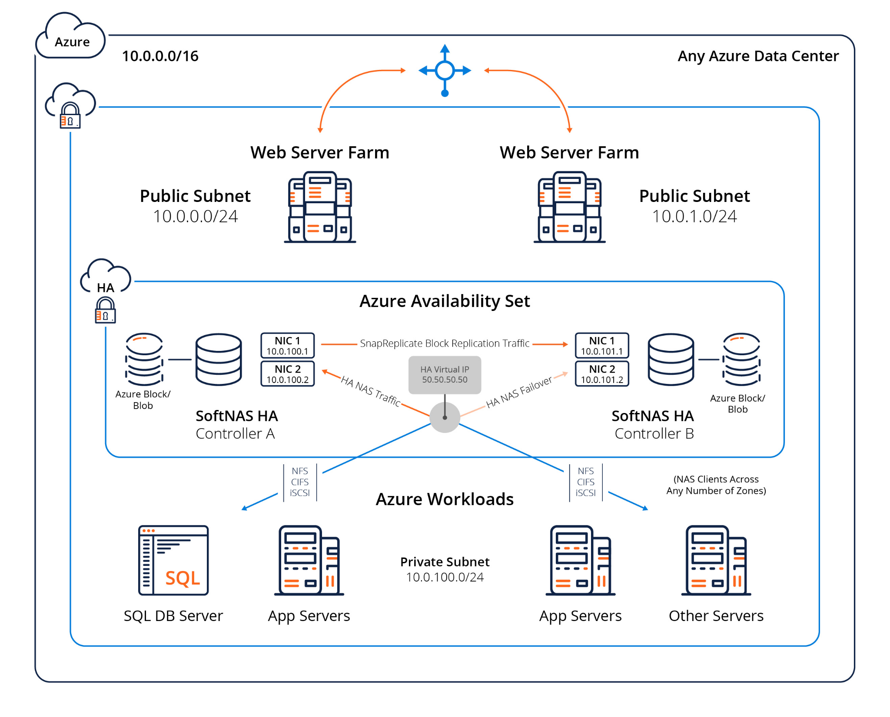
SYSTEM ARCHITECTURE

Slide 22
REFERENCES
Base Paper: https://ieeexplore.ieee.org/document/8017473
1] Amazon, “Summary of the Amazon EC2 and Amazon RDS Service Disruption in the US East Region”, http://aws.amazon.com/message/65648
[2] L. Wang, H. Ramasamy, R. Harper, M. Viswanathan, E. Plattier, “Experiences with Building Disaster Recovery for EnterpriseClass Clouds”, Annual IEEE/IFIP International Conference on Dependable Systems and Networks, pp. 231-238, 2015.
[3] OpenStack, https://www.openstack.org/
[4] ORBIT, EU FP7 project, http://www.orbitproject.eu/
[5] D. Kyriazis, V. Anagnostopoulos, A. Arcangeli, D. Gilbert, D. Kalogeras, R. Kat, C. Klein, P. Kokkinos, Y. Kuperman, J. Nider, P. Svärd, L. Tomas, E. Varvarigos, T. Varvarigou, “High performance fault-tolerance for clouds”, IEEE Symposium on Computers and Communication (ISCC), pp. 251-257, 2015.
[6] C. Oberg, A. Whitt, R. Mills. "Disasters will happen-are you ready?", IEEE Communications Magazine, Vol 1, No. 49, pp. 36- 42, 2011.

Slide 23
THANK YOU

